Slide 1
FAI Unit-IV Hypothesis Representation From: Tom M. Mitchell, Machine Learning, India Edition 2013, McGraw Hill Education.

Slide 2
Hypothesis representation in ML
The hypothesis is a common term in Machine Learning and data science projects.
This assumption in Machine learning is known as Hypothesis.
In Machine Learning, at various times, Hypothesis and Model are used interchangeably. However, a Hypothesis is an assumption made by scientists, whereas a model is a mathematical representation that is used to test the hypothesis.
What is Hypothesis?
The hypothesis is defined as the supposition or proposed explanation based on insufficient evidence or assumptions. It is just a guess based on some known facts but has not yet been proven.
A good hypothesis is testable, which results in either true or false.

Slide 3
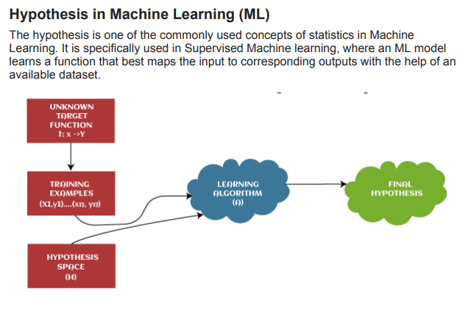

Slide 4
In supervised learning techniques, the main aim is to determine the possible hypothesis out of hypothesis space that best maps input to the corresponding or correct outputs.
There are some common methods given to find out the possible hypothesis from the Hypothesis space, where hypothesis space is represented by uppercase-h (H) and hypothesis by lowercase-h (h).
These are defined as follows:
Hypothesis space (H):
Hypothesis space is defined as a set of all possible legal hypotheses; hence it is also known as a hypothesis set. It is used by supervised machine learning algorithms to determine the best possible hypothesis to describe the target function or best maps input to output. It is often constrained by choice of the framing of the problem, the choice of model, and the choice of model configuration.
Hypothesis (h): It is defined as the approximate function that best describes the target in supervised machine learning algorithms. It is primarily based on data as well as bias and restrictions applied to data. Hence hypothesis (h) can be concluded as a single hypothesis that maps input to proper output and can be evaluated as well as used to make predictions.

Slide 5
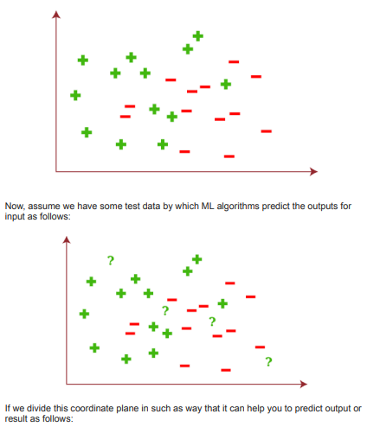
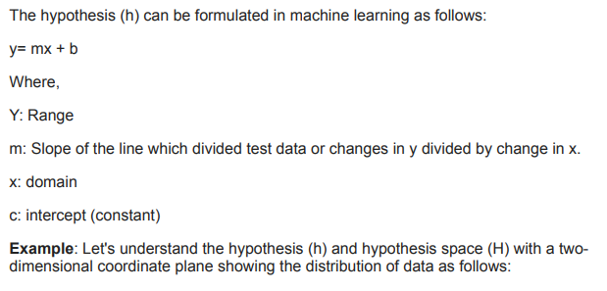

Slide 6
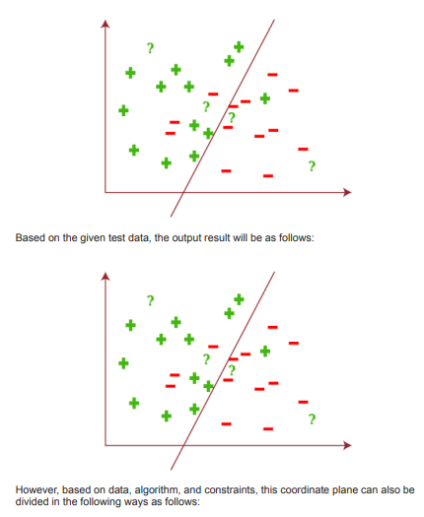
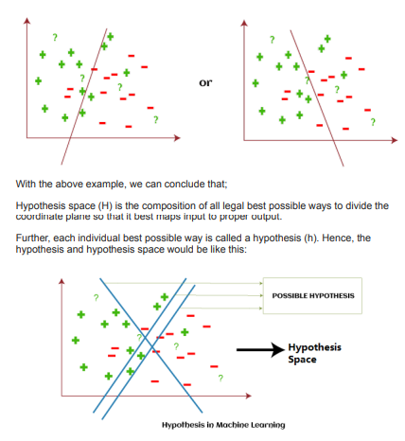

Slide 7
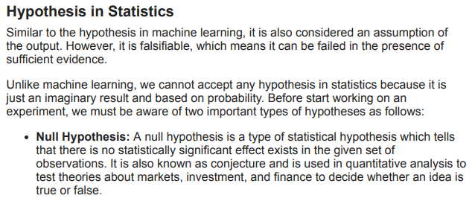
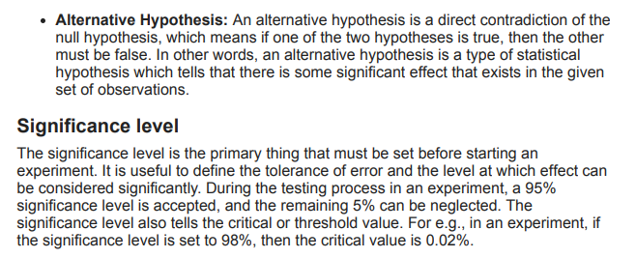

Slide 8
Concept Learning
Learning involves acquiring general concepts from specific training examples. Example: People continually learn general concepts or categories such as "bird," "car," "situations in which I should study more in order to pass the exam," etc.
Each such concept can be viewed as describing some subset of objects or events defined over a larger set
Alternatively, each concept can be thought of as a Boolean-valued function defined over this larger set. (Example: A function defined over all animals, whose value is true for birds and false for other animals).
Concept learning - Inferring a Boolean-valued function from training examples of its input and output

Slide 9
A Concept Learning Task
Consider the example task of learning the target concept
"Days on which my friend Aldo enjoys his favorite water sport."
Example | Sky | AirTemp | Humidity | Wind | Water | Forecast | EnjoySport
1 | Sunny | Warm | Normal | Strong | Warm | Same | Yes
2 | Sunny | Warm | High | Strong | Warm | Same | Yes
3 | Rainy | Cold | High | Strong | Warm | Change | No
4 | Sunny | Warm | High | Strong | Cool | Change | Yes
Table- Describes a set of sample days, each represented by a set of attributes

Slide 10
The attribute EnjoySport indicates whether or not a Person enjoys his favorite water sport on this day.
The task is to learn to predict the value of EnjoySport for an arbitrary day, based on the values of its other attributes ?

Slide 11
What hypothesis representation is provided to the learner?
Let’s consider a simple representation in which each hypothesis consists of a conjunction of constraints on the instance attributes.
Let each hypothesis be a vector of six constraints, specifying the values of the six attributes Sky, AirTemp, Humidity, Wind, Water, and Forecast.
For each attribute, the hypothesis will either
Indicate by a "?' that any value is acceptable for this attribute,
Specify a single required value (e.g., Warm) for the attribute, or
Indicate by a "Φ" that no value is acceptable

Slide 12
The hypothesis that PERSON enjoys his favorite sport only on cold days with high humidity (independent of the values of the other attributes) is represented by the expression
(?, Cold, High, ?, ?, ?)
If some instance x satisfies all the constraints of hypothesis h, then h classifies x as a positive example (h(x) = 1).
The most general hypothesis-that every day is a positive example-is represented by
(?, ?, ?, ?, ?, ?)
The most specific possible hypothesis-that no represented by
(Φ , Φ, Φ, Φ, Φ, Φ)
day is a positive example-is

Slide 13
Notation
The set of items over which the concept is defined is called the set of instances, which we denote by X.
Example: X is the set of all possible days, each represented by the attributes: Sky, AirTemp, Humidity, Wind, Water, and Forecast
The concept or function to be learned is called the target concept, which we denote by c.
c can be any Boolean valued function defined over the instances X c : X {O, 1}
Example: The target concept corresponds to the value of the attribute EnjoySport
(i.e., c(x) = 1 if EnjoySport = Yes, and c(x) = 0 if EnjoySport = No).

Slide 14
Instances for which c(x) = 1 are called positive examples, or members of the
target concept.
Instances for which c(x) = 0 are called negative examples, or non-members of the target concept.
The ordered pair (x, c(x)) to describe the training example consisting of the instance x and its target concept value c(x).
D to denote the set of available training examples
The symbol H to denote the set of all possible hypotheses that the learner may consider regarding the identity of the target concept. Each hypothesis h in H represents a Boolean-valued function defined over X
h : X {O, 1}
The goal of the learner is to find a hypothesis h such that h(x) = c(x) for all x in
X.

Slide 15
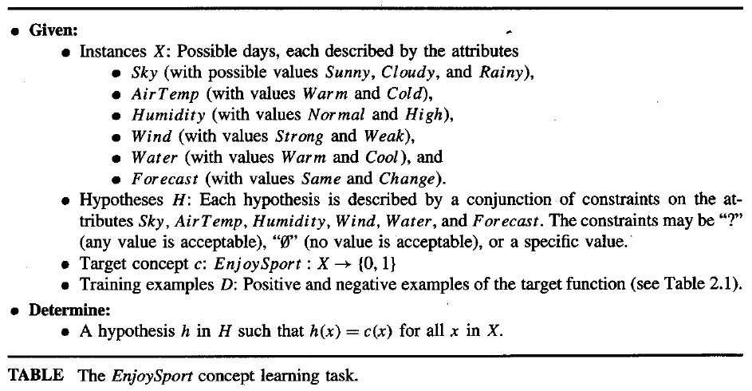

Slide 16
The Inductive Learning Hypothesis
Any hypothesis found to approximate the target function well over a sufficiently large set of training examples will also approximate the target function well over other unobserved examples.

Slide 17
Concept learning as Search
Concept learning can be viewed as the task of searching through a large space of hypotheses implicitly defined by the hypothesis representation.
The goal of this search is to find the hypothesis that best fits the training
examples.
Example, the instances X and hypotheses H in the EnjoySport learning task.
The attribute Sky has three possible values, and AirTemp, Humidity, Wind, Water Forecast each have two possible values, the instance space X contains exactly
3.2.2.2.2.2 = 96 Distinct instances
5.4.4.4.4.4 = 5120 Syntactically distinct hypotheses within H (each attribute add two pie, question mark).
Every hypothesis containing one or more " Φ" symbols represents the empty set of
instances; that is, it classifies every instance as negative.
1 + (4.3.3.3.3.3) = 973. Semantically distinct hypothesis
56

Slide 18
General-to-Specific Ordering of Hypotheses
Consider the two hypotheses
h₁ = (Sunny, ?, ?, Strong, ?, ?)
h₂ = (Sunny, ?, ?, ?, ?, ?)
Consider the sets of instances that are classified positive by h_{l} and by h₂.
h₂ imposes fewer constraints on the instance, it classifies more instances as positive. So, any instance classified positive by h_{l} will also be classified positive by h₂. Therefore, h₂ is more general than h_{l}.
Given hypotheses h_{j} and h_{k}, h_{j} is more-general-than or- equal do h_{k} if and only if any instance that satisfies h_{k} also satisfies h_{i}
Definition: Let h_{j} and h_{k} be Boolean-valued functions defined over X. Then h_{j} is more general-than-or-equal-to h_{k} (written h_{j} ≥ h_{k}) if and only if

Slide 19
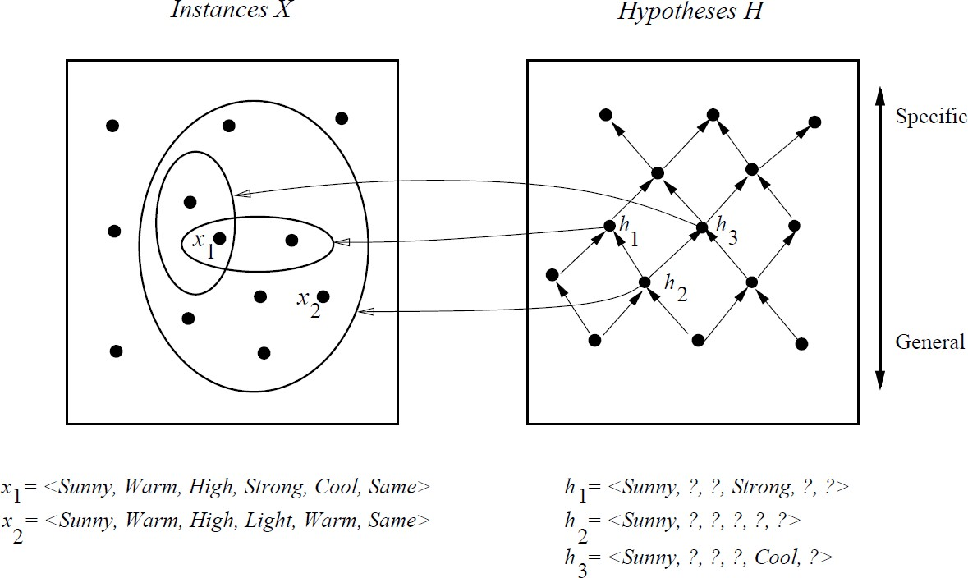
General-to-Specific Ordering of Hypotheses
In the figure, the box on the left represents the set X of all instances, the box on the right the set H of all hypotheses.
Each hypothesis corresponds to some subset of X-the subset of instances that it classifies positive.
The arrows connecting hypotheses represent the more - general -than relation, with the arrow pointing toward the less general hypothesis.
Note the subset of instances characterized by h₂ subsumes the subset characterized by h _{l} , hence h₂ is more - general– than h₁

Slide 20
FIND-S: Finding a Maximally Specific Hypothesis
FIND-S Algorithm
Initialize h to the most specific hypothesis in H
For each positive training instance x
For each attribute constraint a_{i} in h
If the constraint a_{i} is satisfied by x
Then do nothing
Else replace a_{i} in h by the next more general constraint that is satisfied by x
Output hypothesis h

Slide 21
To illustrate this algorithm, assume the learner is given the sequence of training examples from the EnjoySport task
Example | Sky | AirTemp | Humidity | Wind | Water | Forecast | EnjoySport
1 | Sunny | Warm | Normal | Strong | Warm | Same | Yes
2 | Sunny | Warm | High | Strong | Warm | Same | Yes
3 | Rainy | Cold | High | Strong | Warm | Change | No
4 | Sunny | Warm | High | Strong | Cool | Change | Yes
The first step of FIND-S is to initialize h to the most specific hypothesis in H
h - (Ø, Ø, Ø, Ø, Ø, Ø)

Slide 22
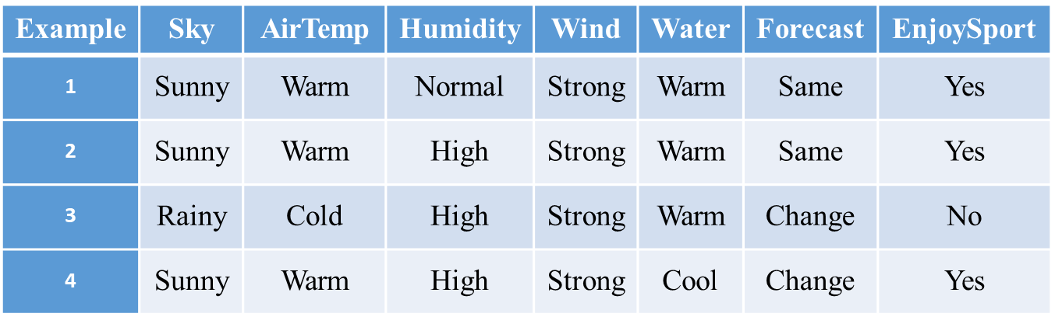
x₁ = <Sunny Warm Normal Strong Warm Same>, +
Observing the first training example, it is clear that our hypothesis is too specific. In particular, none of the "Ø" constraints in h are satisfied by this example, so each is replaced by the next more general constraint that fits the example
h₁ = <Sunny Warm Normal Strong Warm Same>
This h is still very specific; it asserts that all instances are negative except for the single positive training example
x₂ = <Sunny, Warm, High, Strong, Warm, Same>, +
The second training example forces the algorithm to further generalize h, this time substituting a "?' in place of any attribute value in h that is not satisfied by the new example
h₂ = <Sunny Warm ? Strong Warm Same>

Slide 23
x3 = <Rainy, Cold, High, Strong, Warm, Change>, -
Upon encountering the third training the algorithm makes no change to h. The FIND-S algorithm simply ignores every negative example.
h3 = < Sunny Warm ? Strong Warm Same>
x4 = <Sunny Warm High Strong Cool Change>, +
The fourth example leads to a further generalization of h
h4 = < Sunny Warm ? Strong ? ? >

Slide 24
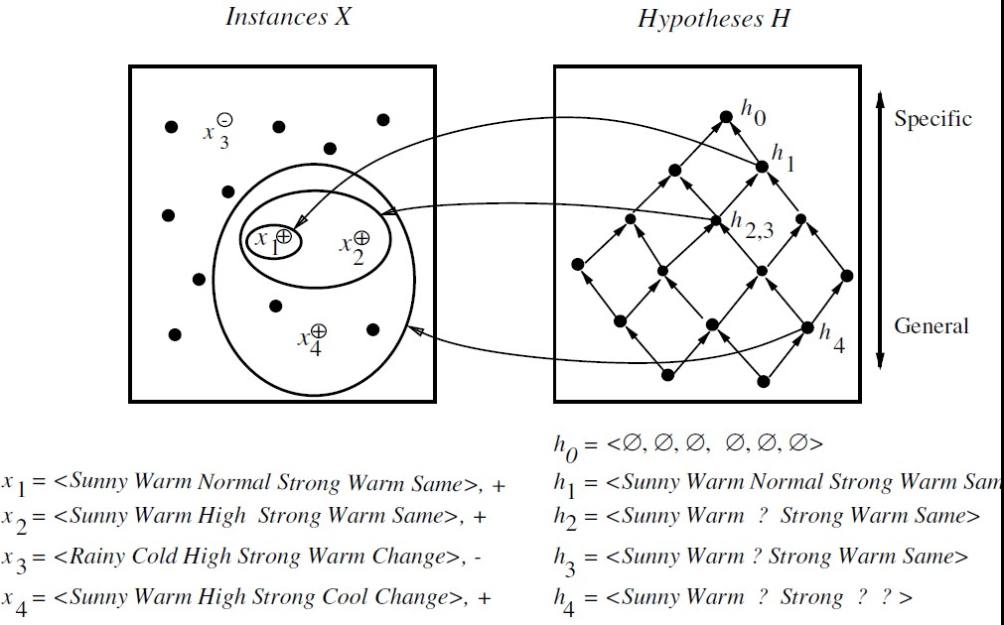

Slide 25
The key property of the FIND-S algorithm is
FIND-S is guaranteed to output the most specific hypothesis within H that is
consistent with the positive training examples
FIND-S algorithm’s final hypothesis will also be consistent with the negative examples provided the correct target concept is contained in H, and provided the training examples are correct.

Slide 26
Unanswered by FIND-S
Has the learner converged to the correct target concept?
Why prefer the most specific hypothesis?
Are the training examples consistent?
What if there are several maximally specific consistent hypotheses?

Slide 27
Version Space and CANDIDATE ELIMINATION Algorithm
The key idea in the CANDIDATE-ELIMINATION algorithm is to output a description of the set of all hypotheses consistent with the training examples
The CANDIDATE-ELIMINTION algorithm computes the version space containing all hypotheses from H that are consistent with an observed sequence of training examples.
Representation
Definition: A hypothesis h is consistent with a set of training examples D if and only if
h(x) = c(x) for each example (x, c(x)) in D.
Consistent(h, D) ≡ (∀ ⟨x, c(x)⟩ ∈ D) h(x) = c(x))
Note difference between definitions of consistent and satisfies
an example x is said to satisfy hypothesis h when h(x) = 1, regardless of whether x is a positive or negative example of the target concept.
an example x is said to consistent with hypothesis h iff h(x) = c(x)

Slide 28
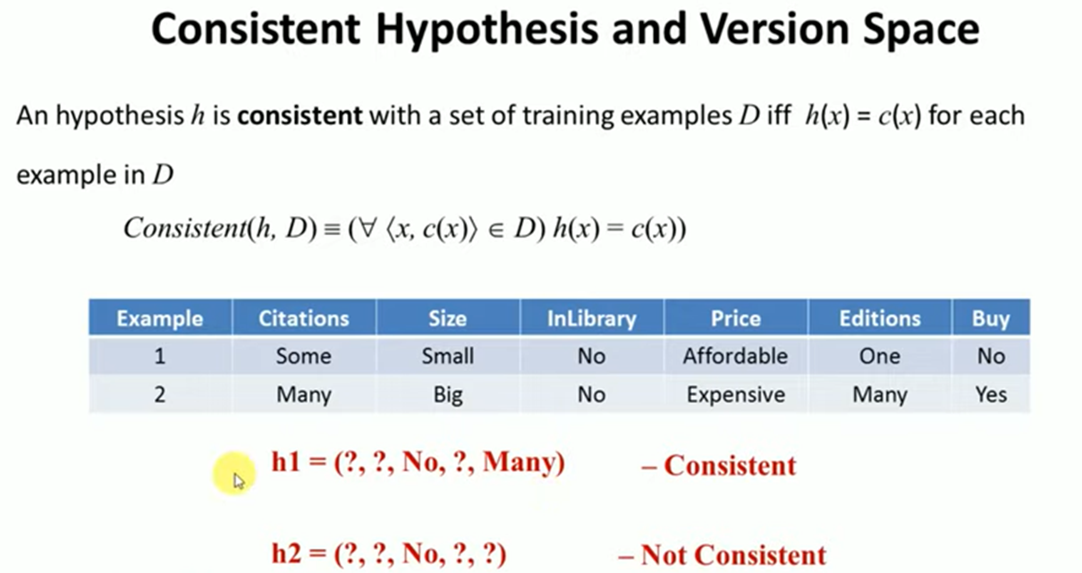
Version Space
A representation of the set of all hypotheses which are consistent with D
Definition: The version space, denoted VS_{H,D} with respect to hypothesis space H and training examples D, is the subset of hypotheses from H consistent with the training examples in D
VS_{H,D} ≡{h ∈ H | Consistent(h, D)}

Slide 29
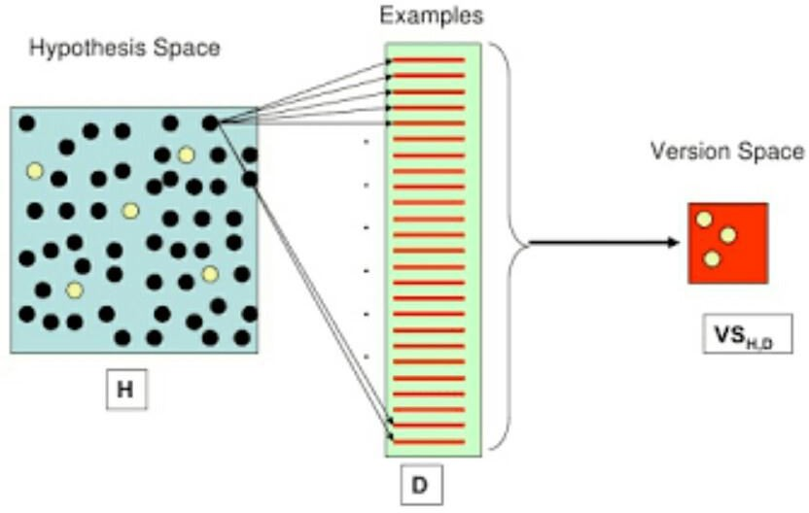

Slide 30
The LIST-THEN-ELIMINATE Algorithm
The LIST-THEN-ELIMINATE algorithm first initializes the version space to contain all hypotheses in H and then eliminates any hypothesis found inconsistent with any training example.
The LIST-THEN-ELIMINATE Algorithm
______________________________________________________________________
VersionSpace c a list containing every hypothesis in H
For each training example, (x, c(x))
remove from VersionSpace any hypothesis h for which h(x) ≠ c(x)
Output the list of hypotheses in VersionSpace
________________________________________________________________________________________________
List-Then-Eliminate works in principle, so long as version space is finite.
However, since it requires exhaustive enumeration of all hypotheses in practice it is not feasible.

Slide 31
A More Compact Representation for Version Spaces
The version space is represented by its most general and least general members.
These members form general and specific boundary sets that delimit the version space within the partially ordered hypothesis space.
Definition: The specific boundary S, with respect to hypothesis space H and training data D, is the set of minimally general (i.e., maximally specific) members of H consistent with D.
S ≡{s ∈ H | Consistent(s, D)∧(¬∃s' ∈ H)[(s >_{g}s') ∧ Consistent(s', D)]}

Slide 32
Version Space representation theorem
Theorem: Let X be an arbitrary set of instances and Let H be a set of Boolean- valued hypotheses defined over X. Let c : X →{O, 1} be an arbitrary target concept defined over X, and let D be an arbitrary set of training examples {(x, c(x))). For all X, H, c, and D such that S and G are well defined,
VS_{H,D}={h ∈ H |(∃s ∈ S) (∃g ∈ G) (g ≥_{g} h ≥_{g} s)}

Slide 33
VS_{H,D}={h ∈ H |(∃s ∈ S) (∃g ∈ G) (g ≥_{g} h ≥_{g} s)}
To Prove:
Every h satisfying the right hand side of the above expression is in VS _{H,D}
Every member of VS _{H,D} satisfies the right-hand side of the expression
Sketch of proof:
let g, h, s be arbitrary members of G, H, S respectively with g ≥_{g} h ≥_{g} s
By the definition of S, s must be satisfied by all positive examples in D. Because h ≥_{g} s , h must also
be satisfied by all positive examples in D.
By the definition of G, g cannot be satisfied by any negative example in D, and because g ≥_{g} h h cannot be satisfied by any negative example in D. Because h is satisfied by all positive examples in D and by no negative examples in D, h is consistent with D, and therefore h is a member of VS_{H,D}
It can be proven by assuming some h in VS_{H,D},that does not satisfy the right-hand side of the expression, then showing that this leads to an inconsistency

Slide 34
CANDIDATE-ELIMINATION Learning Algorithm
Initialize G to the set of maximally general hypotheses in H Initialize S to the set of maximally specific hypotheses in H For each training example d, do
If d is a positive example
Remove from G any hypothesis inconsistent with d
For each hypothesis s in S that is not consistent with d
Remove s from S
Add to S all minimal generalizations h of s such that
h is consistent with d, and some member of G is more general than h
Remove from S any hypothesis that is more general than another hypothesis in S
If d is a negative example
Remove from S any hypothesis inconsistent with d
For each hypothesis g in G that is not consistent with d
Remove g from G
Add to G all minimal specializations h of g such that
h is consistent with d, and some member of S is more specific than h
Remove from G any hypothesis that is less general than another hypothesis in G

Slide 35
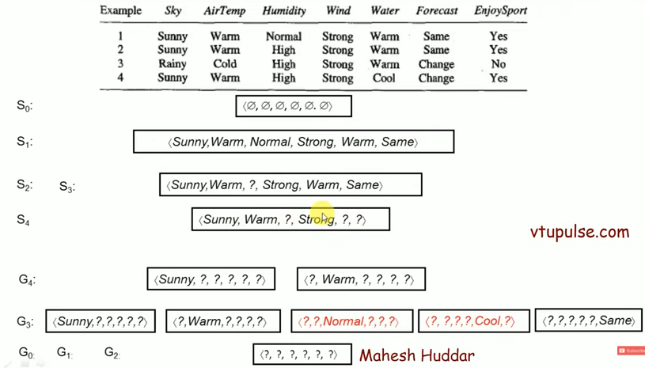

CANDIDATE-ELIMINATION Learning Algorithm-Example

Slide 36
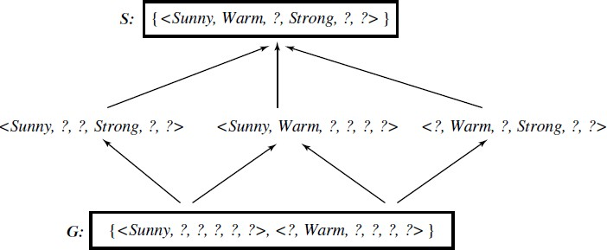
Learned Version space from Candidate elimination algorithms

Slide 37
Inductive Bias (Learning bias)
The fundamental questions for inductive inference
What if the target concept is not contained in the hypothesis space?
Can we avoid this difficulty by using a hypothesis space that includes every possible
hypothesis?
How does the size of this hypothesis space influence the ability of the algorithm to generalize to unobserved instances?
How does the size of the hypothesis space influence the number of training examples
that must be observed?

Slide 38
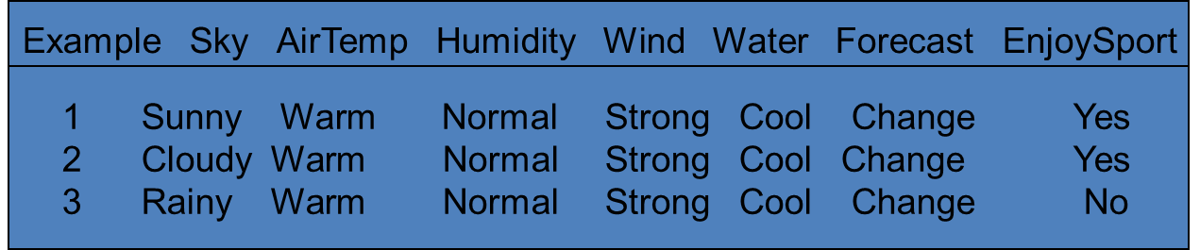
Inductive bias: 1. Effect of incomplete hypothesis space ( Biased Hypothesis space)
Preceding algorithms work if target function is in H
Will generally not work if target function not in H
Consider following examples which represent target function
“sky = sunny or sky = cloudy”:
If apply Candidate Elimination algorithm as before, end up with empty Version Space
After first two training example
S2= ⟨? Warm Normal Strong Cool Change⟩
New hypothesis is overly general and it covers the third negative training example! Our H does not include the appropriate c

Slide 39
Inductive bias: 2. An Unbiased Learner
Incomplete hypothesis space
If c not in H, then consider generalizing representation of H to contain c
The size of the instance space X of days described by the six available attributes is 96. The number of distinct subsets that can be defined over a set X containing |X| elements (i.e., the size of the power set of X) is 2^{|X|}
Recall that there are 96 instances in EnjoySport; hence there are 2⁹⁶ possible hypotheses
in full space H
Can do this by using full propositional calculus with AND, OR, NOT
Hence H defined only by conjunctions of attributes is biased (containing only 973 h’s)

Slide 40
Let us reformulate the Enjoysport learning task in an unbiased way by defining a new hypothesis space H' that can represent every subset of instances; that is, let H' correspond to the power set of X.
One way to define such an H' is to allow arbitrary disjunctions, conjunctions, and
negations of our earlier hypotheses.
For instance, the target concept "Sky = Sunny or Sky = Cloudy" could then be described as
(Sunny, ?, ?, ?, ?, ?) V (Cloudy, ?, ?, ?, ?, ?)

Slide 41
Inductive learning requires some form of prior assumptions, or inductive bias Definition:
Inductive bias: 3. The futility of biased Free learning
Consider a concept learning algorithm L for the set of instances X.
Let c be an arbitrary concept defined over X
Let D_{c} = {( x , c(x))} be an arbitrary set of training examples of c.
Let L(x_{i}, D_{c}) denote the classification assigned to the instance x_{i} by L after training on the data D_{c}.
The inductive bias of L is any minimal set of assertions B such that for any target concept c and corresponding training examples D_{c}
(∀ ⟨x_{i} ∈ X ) [(B ∧ D_{c} ∧ x_{i}) ├ L(x_{i}, D_{c})]

Slide 42
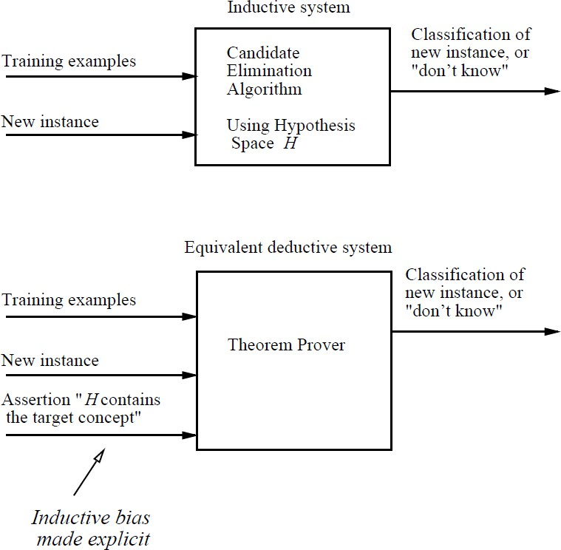
Modelling inductive systems by equivalent deductive systems.
The input-output behavior of the
CANDIDATE-ELIMINATION
algorithm using a hypothesis space H is identical to that of a deductive theorem prover utilizing the assertion "H contains the target concept." This assertion is therefore called the inductive bias of the CANDIDATE- ELIMINATION algorithm. characterizing inductive systems
by their inductive bias allows modelling them by their equivalent deductive systems. This provides a way to compare inductive systems according to their policies for generalizing beyond the observed training data.

Slide 43
Ranking Inductive Learners according to their Biases
Weak
Rote-Learner: This system simply memorizes the training data and their classification--- No generalization is involved.
Candidate-Elimination: New instances are classified only if all the hypotheses in the version space agree on the classification
Find-S: New instances are classified using the most specific hypothesis consistent with the training data
Bias
Strength
Strong

Slide 44
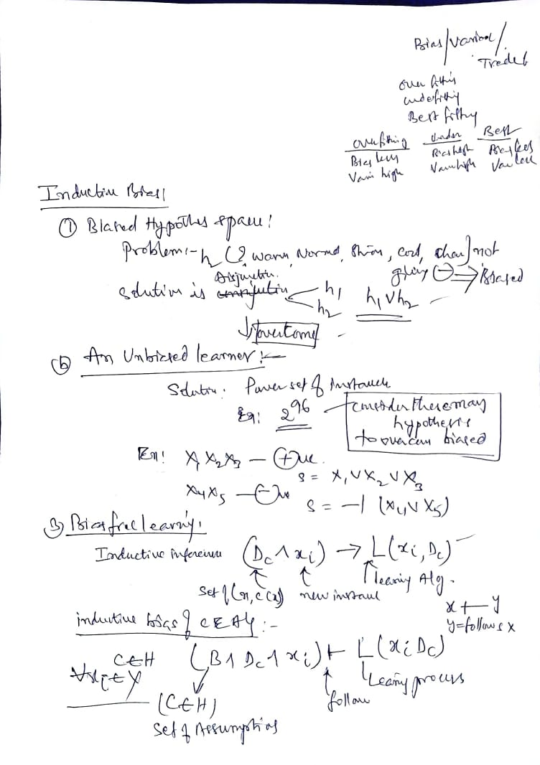

Slide 45
